Slide 1
Customer Personalization Strategy
Use data-driven insights to build customer personas and use the same to drive optimized marketing strategies

Slide 2
Contents
Introduction & Problem Statement
Executive Summary
Dataset Overview & Quality
Customer Behaviour Analysis
Customer Personas & Segmentation
Personalization Opportunities
Predictive Modelling Performance
Suggestions & Roadmap
Customer Lifetime Value Integration

Slide 3
Introduction & Problem Statement
Business Goal
Increase conversion rates and drive revenue growth by leveraging customer data for personalised experiences.
Data Advantage
100,000 customer records with behavioural and demographic insights.
Proposed Solution
Utilise customer data to identify high-value segments, create personalised marketing campaigns, and predict customer conversion.

Slide 4
Executive Summary
Key Findings:
7 distinct customer personas identified with conversion rates ranging from 12% to 82%
Prior product interest increases conversion by 2.8x (71.6% vs 25.8%)
Segment ‘A’ customers achieve 2.4x higher conversion than Segment ‘C’ (51.4% vs 21.8%)
‘Active’ customers convert 3.5x more than ‘Dormant’ customers (41.4% vs 12.0%)
Customers in 30-44 years age bracket show 2.2x higher conversion rate than those in the 60+ age group (36.2% vs 16.8%)
They are also the most ‘Active’ and have the largest volume of segment ‘A’ customers.
Baseline predictive model performed 1.8x better than an advanced model in identifying actual purchases accurately.
Strategic Recommendations:
Implement persona-based personalization strategies
Prioritize high-intent and premium active customer segments
Deploy retention campaigns for at-risk dormant customers
Potentially look at adding granular recency, purchase value & type

Slide 5
Dataset Overview & Quality
📊 100,000 anonymized customer records analysed
✅ 99.5% data completeness (only 493 records required imputation)
🎯 30% baseline conversion rate across all customers
🔍 9.2% of customers showed prior product interest
👤 Age range: 18-75 years (median: 36 years)

Slide 6
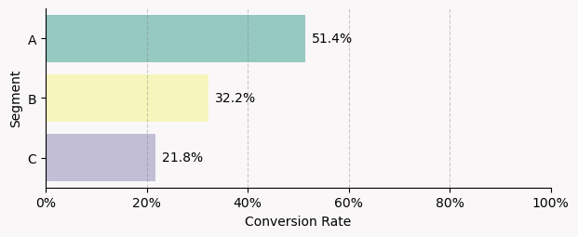
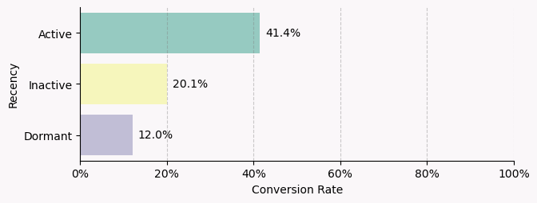
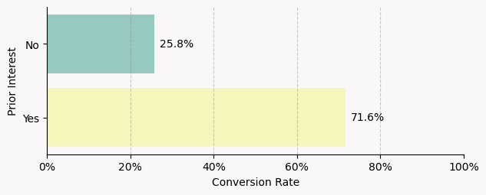
Customer Behaviour Analysis
Segment Performance Insights:
Segment A: 21% of customers – ‘Premium performers’ 🏆
Segment B: 20% of customers – ‘Mid-tier potential’
Segment C: 58.5% of customers – ‘Volume opportunity’ 📊
Customer Engagement Patterns:
Active: 55% of customers - Primary target ⚡
Inactive: 22% of customers - Re-engagement needed
Dormant: 22% of customers - Retention critical
Recency drives 2.8x more conversion success ⏰
Prior Interest Impact:
9.2% customers showed prior interest, but with 71.6% conversion
Customers above 60 are 3.8x more likely to convert

Slide 7
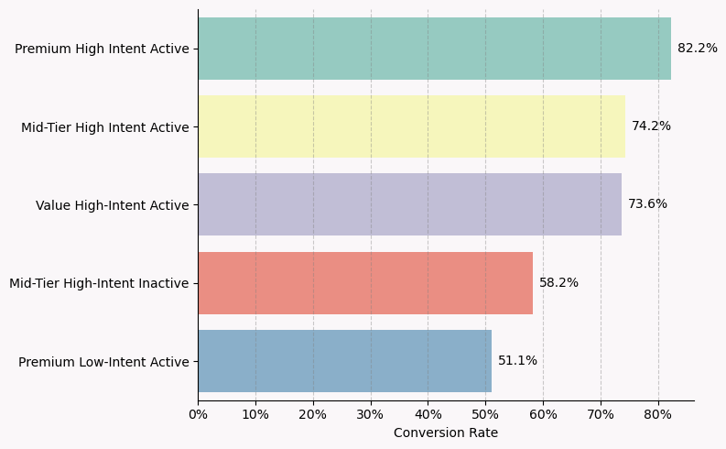
Top Customer Personas & Segmentation
🎯 Premium High-Intent Active: 36% customers
Segment A + Active + Prior Interest
⭐ Mid-Tier High-Intent Active: 14% customers
Segment B + Active + Prior Interest
💎 Value High-Intent Active: 23% customers
Segment C + Active + Prior Interest
⚠️ Mid-Tier High-Intent Inactive : 2.5% customers
Segment B + Inactive + Prior Interest
🏆 Premium Low-Intent Active: 14% customers
Segment A + Active + No Prior Interest

Slide 8
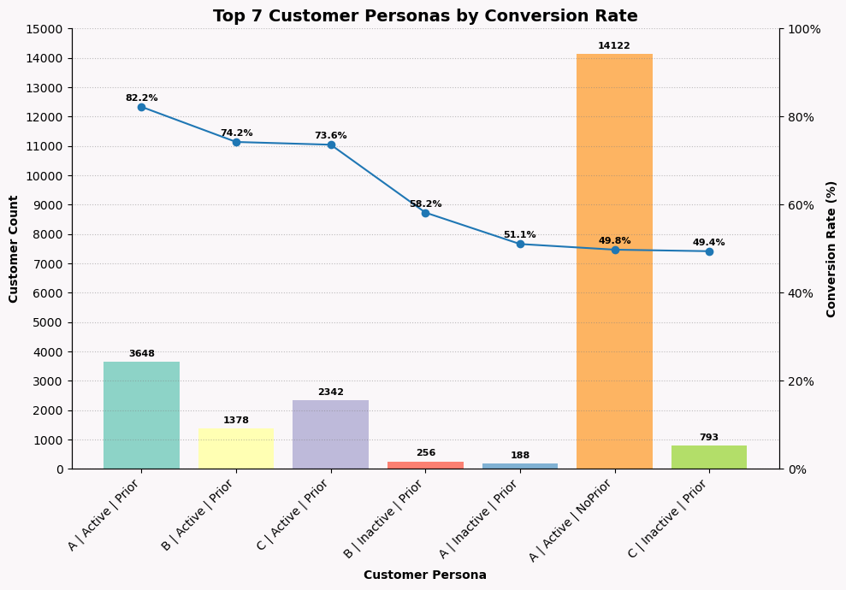
Personalization Opportunities by Persona
High-Intent Active Customers (80-70% conversion):
Exclusive product access and early releases
Dedicated customer success manager
High-Intent Inactive Customers (60-50% conversion):
Educational content and guides
Competitive pricing and value messaging
Premium Active Customers (50% conversion):
Loyalty rewards and tier progression
Personalized content and communications
Dormant/At-Risk Customers (12-20% conversion):
Win-back campaigns with compelling offers
Special promotions and incentives

Slide 9
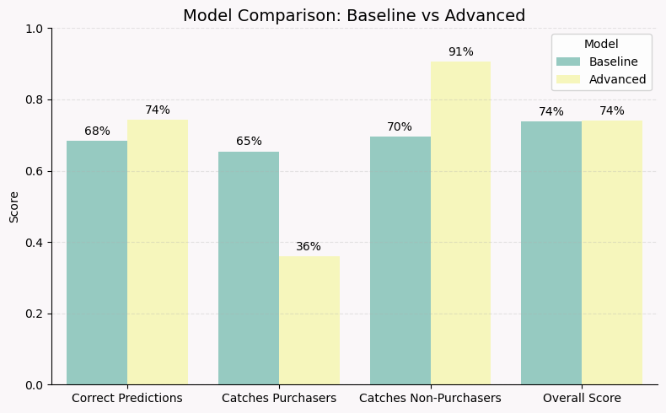
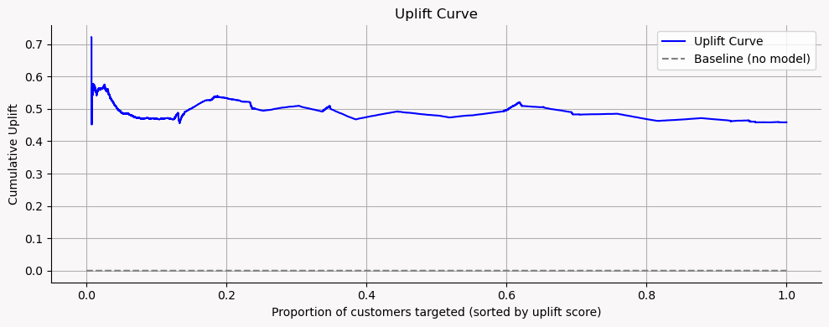
Predictive Modelling Performance
🤖 Baseline model identifies 65%, as against 36% by an advanced model, of ‘likely’ buyers - Ideal for targeting conversions.
🔍 Top Predictors: Prior Interest (37%), Recency (24%), Segment (16%)
⚠️ Limitation: Conservative bias toward non-purchase predictions
📊 Used uplift modelling to identify customer conversions driven by marketing, thereby optimizing marketing spend.
🎯 Identified 4 groups as ‘Persuadable’, ‘Sure Things’, ‘Do Not Disturb’, and ‘Lost Causes’.
💡 Adjacent curve shows that targeted campaigning yields a positive incremental effect, but the overall uplift is modest.

Slide 10
Suggestions & Roadmap
Immediate Actions (Next 30 Days):
Prioritize High-Intent Active customers for VIP treatment & basic email personalization
Implement segment-based product recommendations
Launch retention campaigns for 22,275 dormant customers
Strategic Initiatives (Next 90 Days):
Deploy predictive analytics for automated personalization
Create persona-based content and messaging frameworks
Integrate personalization across all customer touchpoints
Long-term Vision (6-12 Months):
Build comprehensive customer data platform
Implement real-time personalization across all channels
Develop advanced recommendation algorithms
Success Metrics
Conversion rate improvement by persona
Customer lifetime value growth
Revenue per customer increase

Slide 11
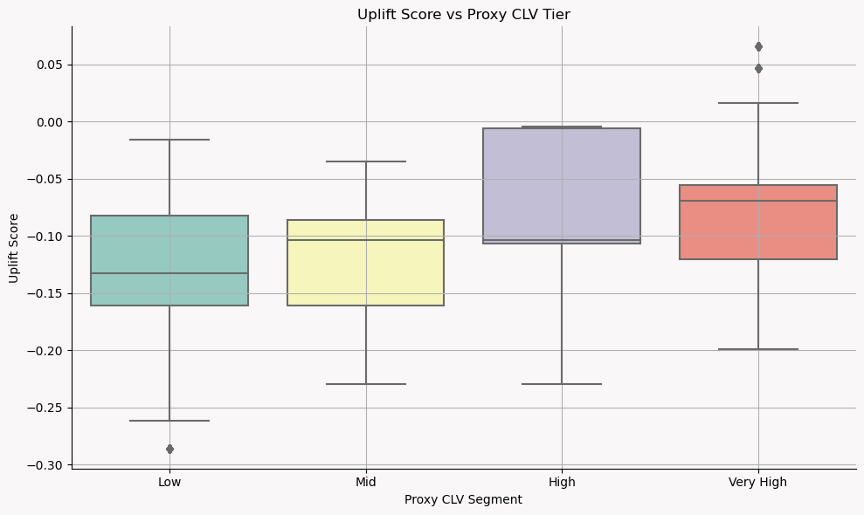
Customer Lifetime Value Integration
Combine behavioural segments with a proxy CLV to prioritize retention spend.
Proxy CLV = Expected Purchase Value × Expected Purchase Frequency × Expected Tenure / Retention
‘Purchase Frequency’ derived from ‘Segment’, ‘Prior Interest’, & ‘Recency’.
‘Retention / Tenure’ derived from ‘Age’, ‘Recency’, & ‘Prior Interest’.
Assumptions
Assume £100 AOV for all
CLV Segments of 'Low', 'Mid', 'High', 'Very High’
Key Insights
Current strategy especially ineffective for low and mid-value tiers
Use Cases
Provide personalised marketing focus areas

Slide 12
Thank You and Q&A

